Slide 1
Introduction to Machine Learning
Week 4

Slide 2
What is AI?
An ability – perceiving, synthesizing, and inferring information – demonstrated by machines, as opposed to intelligence displayed by non-human animals and humans.
Example tasks – speech recognition, computer vision, translation between (natural) languages, object detection, clusterization, dimensionality reduction, recommendation systems, automated decision-making, etc.

Slide 3
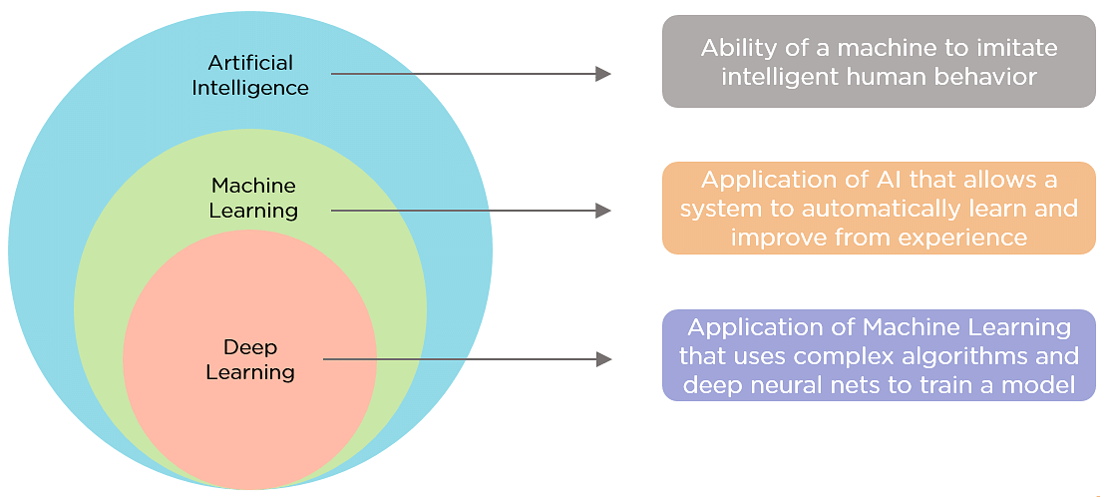

Slide 4
What is Machine learning?
Machine learning (ML) is a field devoted to understanding and building methods that learn, that is, methods that leverage data to improve performance on some set of tasks.
Machine learning algorithms build a model based on sample data, known as training data, in order to make predictions or decisions without being explicitly programmed to do so.
Traditional Programming
Machine Learning
Data
Data
Computer
Output
Computer
Program (function)
Program
Output

Slide 5
When do we need ML
Human expertise does not exist (navigating on Mars)
Humans can’t explain their expertise (speech recognition)
Models must be customized (personalized medicine)
Models are based on huge amounts of data (genomics)
ML is not useful in tasks that can be solved without ML (e.g., calculating the ballistic trajectory of a rocket)

Slide 6
Types of learning
Supervised (inductive) learning
Given: training data + desired outputs (labels)
Unsupervised learning
Given: training data (without desired outputs)
Semi-supervised learning
Given: training data + a few desired outputs
Reinforcement learning
Given: rewards from sequence of actions

Slide 7
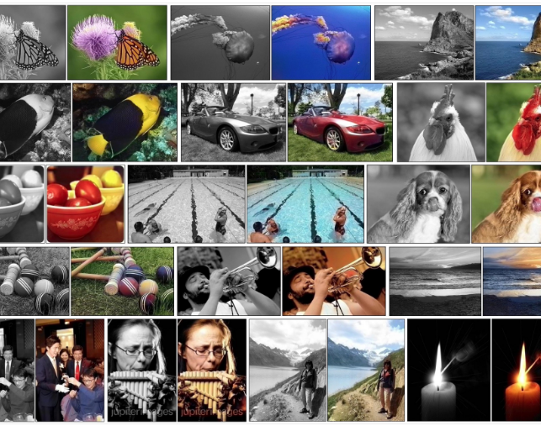
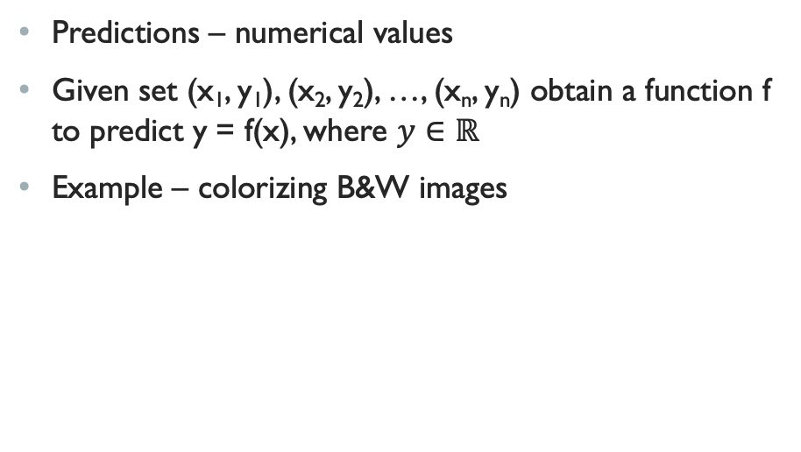
Suprvised learning: regression
Predictions – numerical values
Given set (x₁, y₁), (x₂, y₂), …, (x_{n}, y_{n}) obtain a function f to predict y = f(x), where $y∈ℝ$
Example – colorizing B&W images

Slide 8
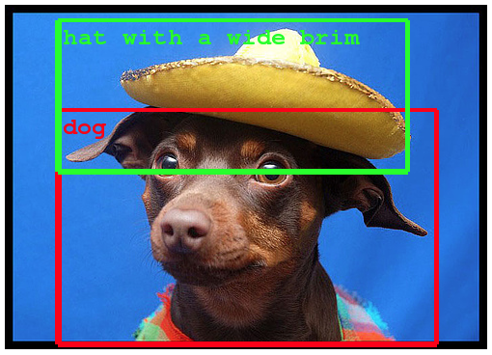
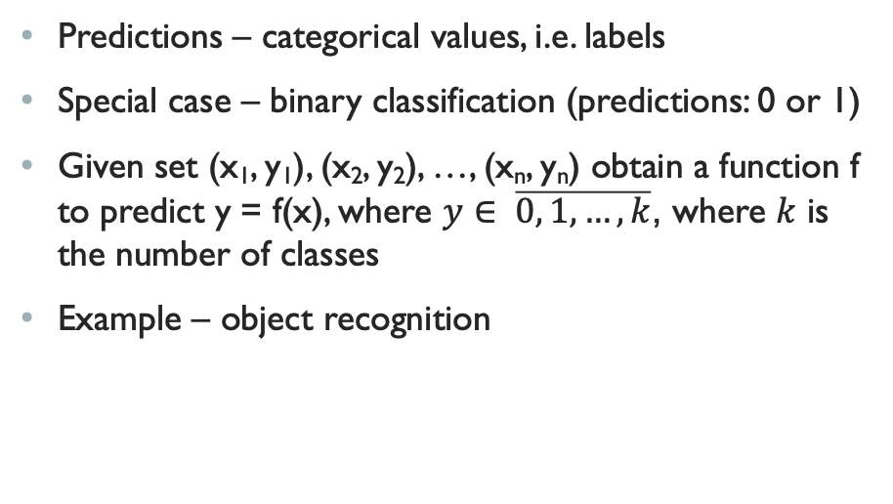
Suprvised learning: Classification
Predictions – categorical values, i.e. labels
Special case – binary classification (predictions: 0 or 1)
Given set (x₁, y₁), (x₂, y₂), …, (x_{n}, y_{n}) obtain a function f to predict y = f(x), where $y∈ \overline{0, 1, …, k}$, where $k$ is the number of classes
Example – object recognition

Slide 9
unSuprvised learning
Given set (x₁, x₂, …, x_{n}) obtain a function f to calculate f(x) without the information about labels
Types of unsupervised learning:
clustering: group data according to "distance"
association: find frequent co-occurrences
link prediction: discover relationships in data
data reduction: project features to fewer features (reduce the dimensionality of samples)

Slide 10
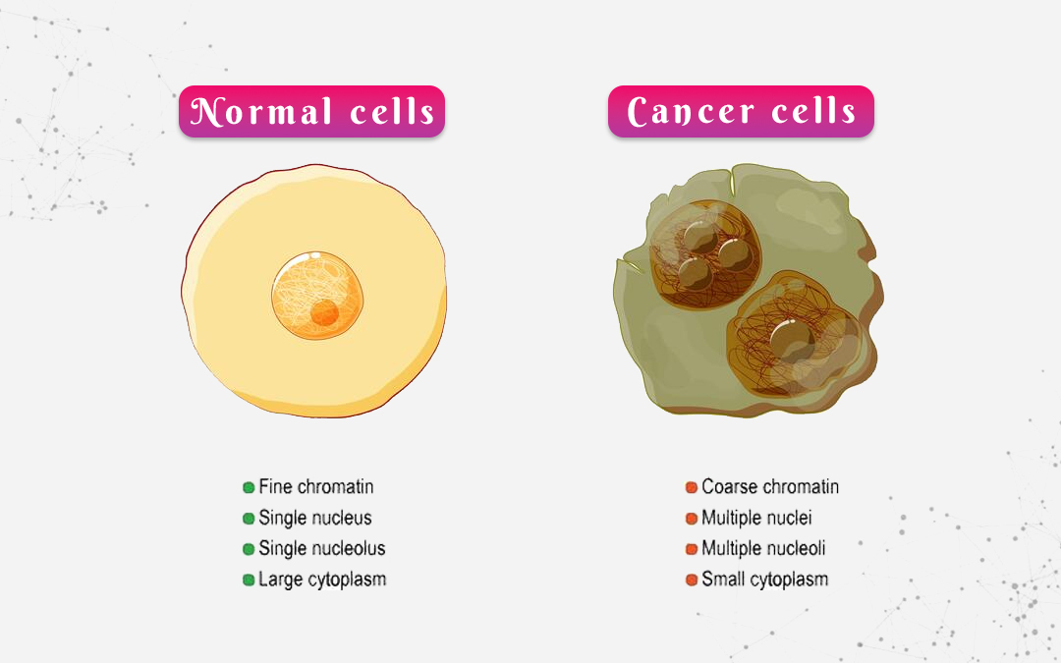
unSuprvised learning: clustering
Clustering: identification of cancer cells

Slide 11
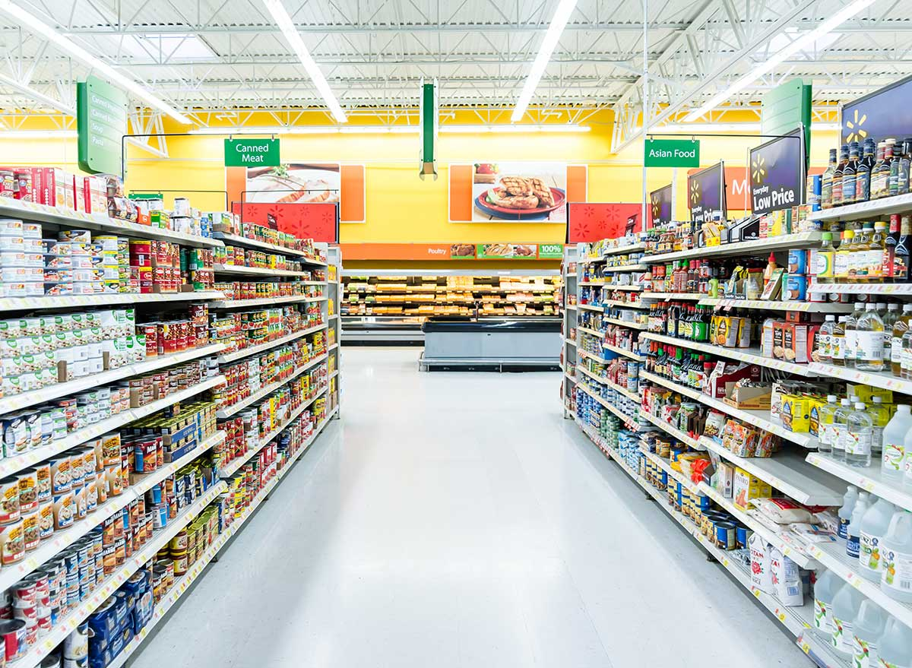
unSuprvised learning: assosiation
Assosiation: retail sales to find the best way to place items in a store
For example, at first glance, newborn diapers and razors seem statistically independent, with no apparent correlation. But rule mining would dig deeper into the transaction frequency and find out that some sales include both items.
So instead of simply learning that 1% of shoppers buy diapers and 10% buy razor blades, the association system generates a new rule that 50% of all shoppers purchasing newborn diapers will also buy razor blades, which can be beneficial information for marketing campaigns.

Slide 12
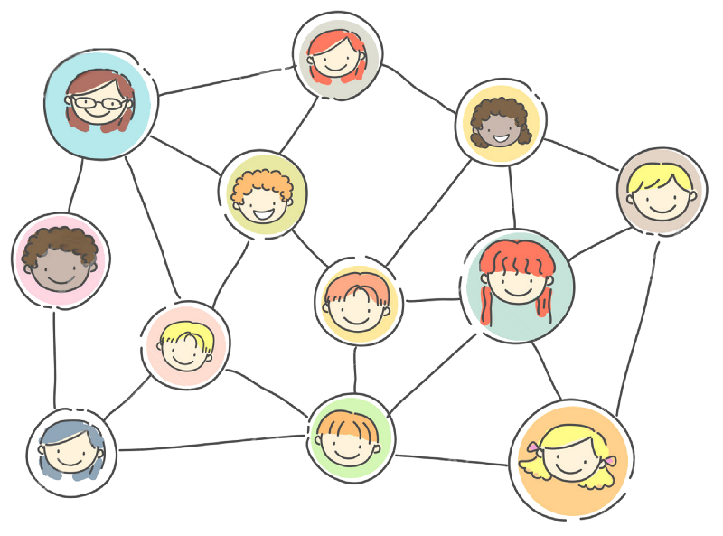
unSuprvised learning: link prediction
Link prediction: prediction potential friends in a social network based on existing connections

Slide 13
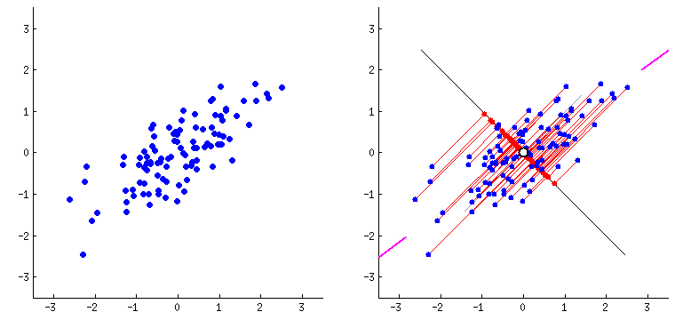
unSuprvised learning: data reduction
Principal component analysis (PCA)
The main linear technique for dimensionality reduction that performs a linear mapping of the data to a lower-dimensional space in such a way that the variance of the data in the low-dimensional representation is maximized.

Slide 14
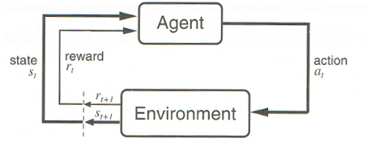
Reinforcement learning
Given a sequence of states and actions with rewards (immediate or delayed), output a policy.
Policy – a rule of choosing an action of the model given a certain state within the environment
In other words, policy – a mapping of states and actions

Slide 15
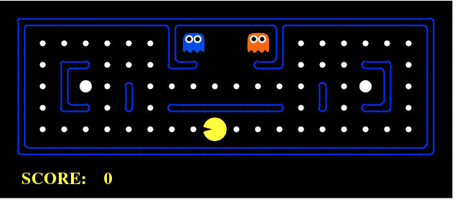
Reinforcement learning: examples
In real life: any of the learned features of behaviour of a human being
For computers: bots and rivals in video games

Slide 16
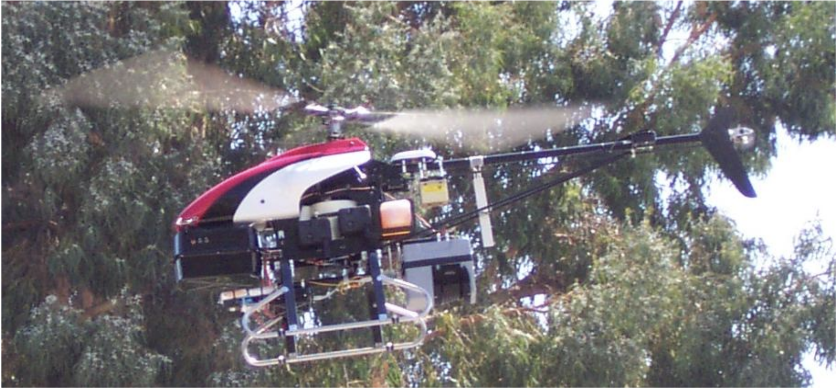
Inverse Reinforcement learning
Inverse RL: learning a policy based on demonstrations of correct/incorrect behavior
Example: avoiding obstacles by small autonomous vehicles

Slide 17
Designing a learning system
Choose the training experience/data
Choose exactly what is to be learned: the target function
Choose how to represent the target function
Choose a learning algorithm to infer the target function from the experience

Slide 18
ML algorithms: classification
Logistic Regression
Logistic regression is a calculation used to predict a binary outcome
Independent variables are analyzed to determine the binary outcome with the results falling into one of two categories. The independent variables can be categorical or numeric, but the dependent variable is always categorical.
Written like this: P(Y=1|X) or P(Y=0|X)
It calculates the probability of dependent variable Y, given independent variable X.

Slide 19
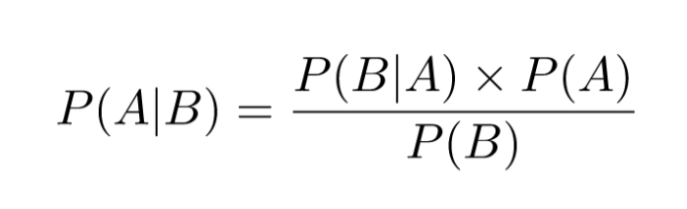
ML algorithms: classification
Naive Bayes
Naive Bayes calculates the possibility of whether a data point belongs within a certain category or does not.
To decide whether or not a sample B belongs to any given category A you need to calculate:

Slide 20
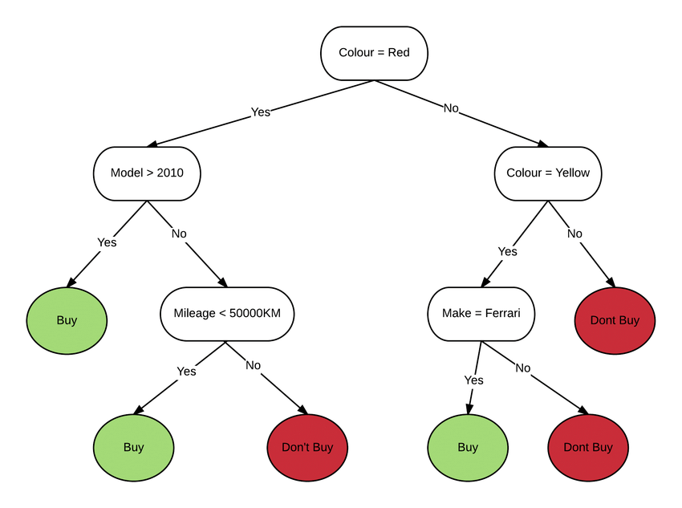
ML algorithms: classification
Decision Trees
Decision Trees (DTs) are a non-parametric supervised learning method used for classification and regression. The goal is to create a model that predicts the value of a target variable by learning simple decision rules inferred from the data features. A tree can be seen as a piecewise constant approximation.

Slide 21
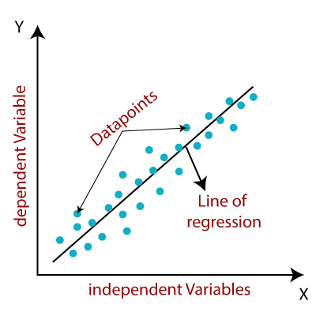
ML algorithms: regression
Linear Regression
One of the most-used regression algorithms in Machine Learning.
Linear regression algorithm is used if the labels are continuous, like the number of flights daily from an airport, etc. The representation of linear regression is y = b*x + c.

Slide 22

ML algorithms: regression
Random forest
Random forest is also a widely-used algorithm for non-linear regression in Machine Learning. Unlike decision tree regression (single tree), a random forest uses multiple decision trees for predicting the output. Random data points are selected from the given dataset (say k data points are selected), and a decision tree is built with them via this algorithm. Several decision trees are then modeled that predict the value of any new data point.

Slide 23
Deep learning
Deep Learning is part of a family of machine learning methods based on Artificial Neural Networks.
It is a class of ML algorithms that uses multiple layers to progressively extract higher-level features from the raw input.
For example, in image processing, lower layers may identify edges, while higher layers may identify the concepts relevant to a human such as digits or letters or faces.
Learning can be supervised, semi-supervised or unsupervised.
Models can be used for classification, regression, data generation, dimensionality reduction, clusterization, etc.

Slide 24
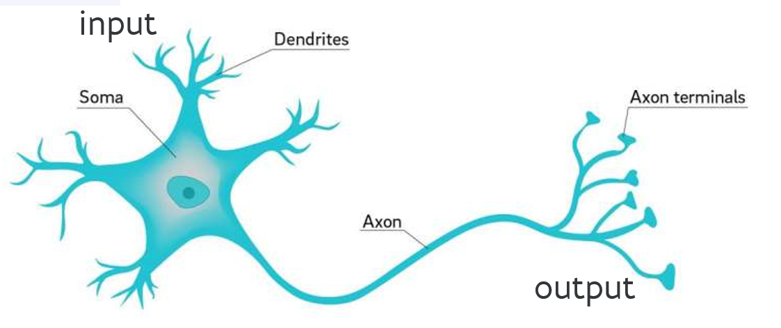
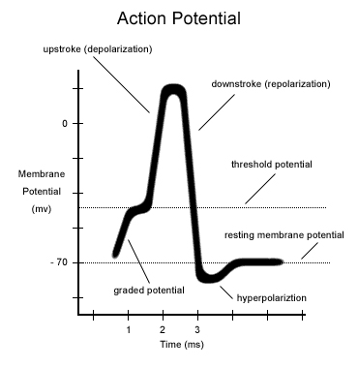

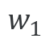
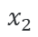
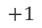
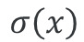
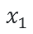
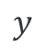
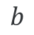
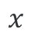

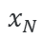
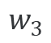
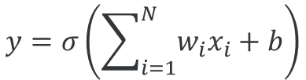
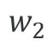
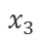
From biological to artificial neurons
inspiration
$$x_{1}$$
$$w_{1}$$
$$x_{2}$$
$$w_{2}$$
$$y$$
$$w_{3}$$
$$y=σ\left(\sum_{i=1}^{N}{w_{i}x_{i}+b}\right)$$
$$σ\left(x\right)$$
$$x_{3}$$
$$b$$
activation function
...
$$+1$$
$$w_{N}$$
$$x_{N}$$
$$x$$

Slide 25
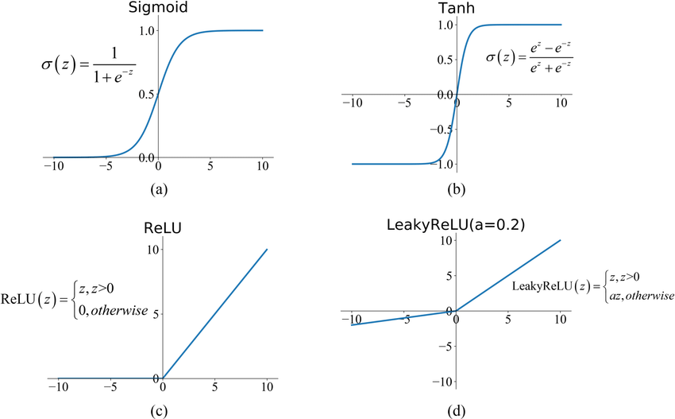
Activation functions

Slide 26
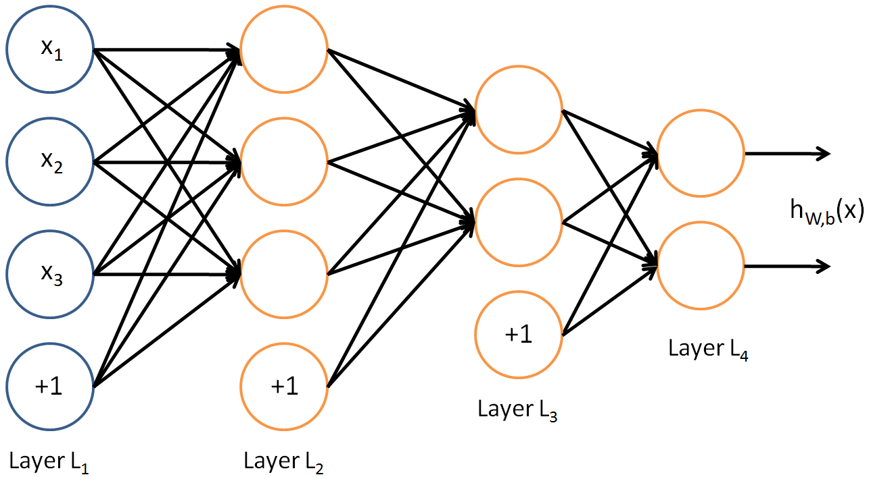
Multilayer perceptron

Slide 27
training
Initialize weights "randomly"
For all training epochs:
for all input-output in training set
using input, compute output (forward)
compare computed output with training output: compute the loss function
adapt weights (backward) to improve output: backpropagation
if accuracy is good enough, stop

Slide 28
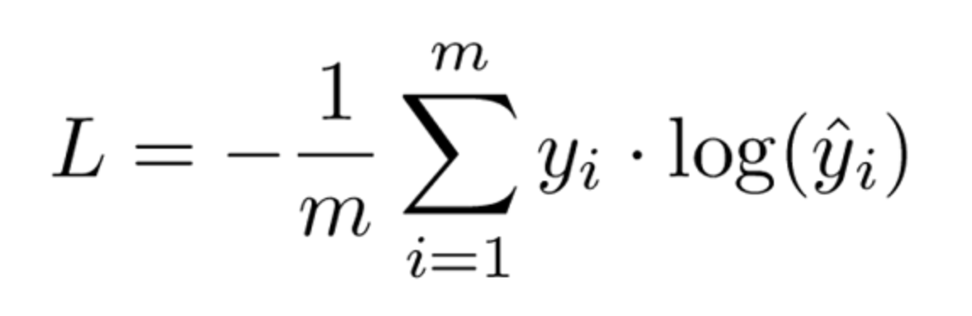
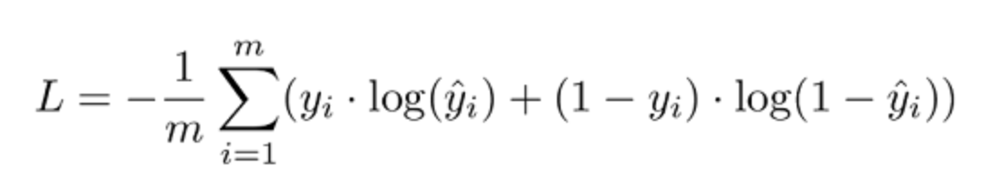
Loss functions
Losses for classification
Cross-entropy loss
Binary cross-entropy loss

Slide 29
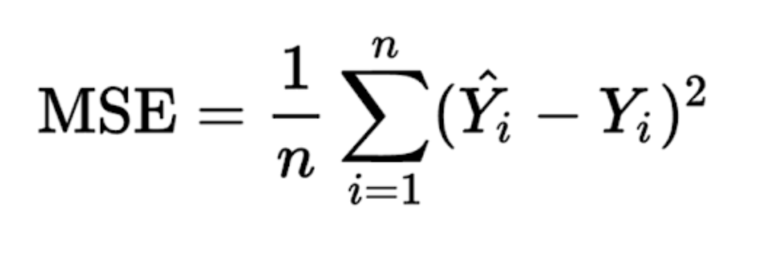
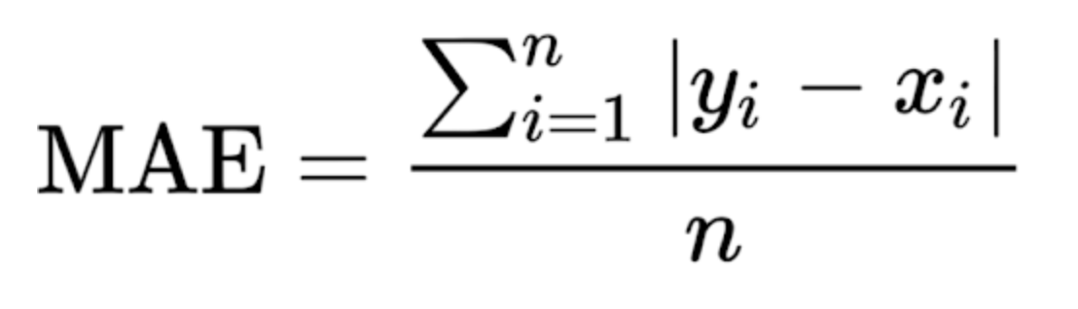
Loss functions
Losses for regression
Mean square error / Quadratic loss / L2 loss
Mean absolute error / L1 loss

Slide 30

frameworks
Scikit-learn
Simple and efficient tools for predictive data analysis
Accessible to everybody, and reusable in various contexts
Built on NumPy, SciPy, and matplotlib
Open source, commercially usable - BSD license
Methods for classification, regression, clustering, dimensionality reduction, model selection, data preprocessing
Only ”classic” Machine Learning, no DL

Slide 31


frameworks
Tensorflow
fast, flexible, and scalable open-source machine learning library for research and production.
combines various Deep Learning models and algorithms
Can be run either on CPUs, GPUs, or TPUs
Developed by Google
Has a simple a flexible API built on top Tensorflow2 – Keras

Slide 32


frameworks
PyTorch
Analogous to Tensorflow in terms of functionality, it is an open-source deep learning framework built to be flexible and modular for research, with the stability and support needed for production deployment.
Developed by Meta AI
Has a simple API build on top – PyTorch Lightning

